Slide 1
Econ 106
Lecture 18
slides derived from:
https://r4ds.had.co.nz/graphics-for-communication.html

Slide 2
Reminders
Lab 5 is due Sunday, 11:59pm (best 4 of 5 labs count)
Final Project is due Sunday, 11:59pm
https://pollev.com/vsovero

Slide 3
Extra Credit Opportunity
Please fill out a teaching evaluation: https://ieval.ucr.edu/ieval/login
Extra credit will be based on the class response rate:
25% response rate→ add .25% to your overall grade
50% response rate→ add .50% to your overall grade
75% response rate→ add .75% to your overall grade
100% response rate→ add 1% to your overall grade
Deadline: Friday 11:59pm

Slide 4
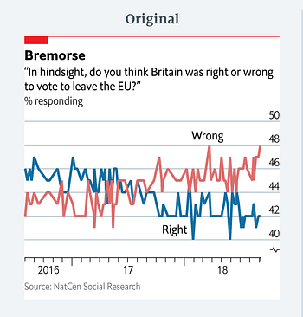
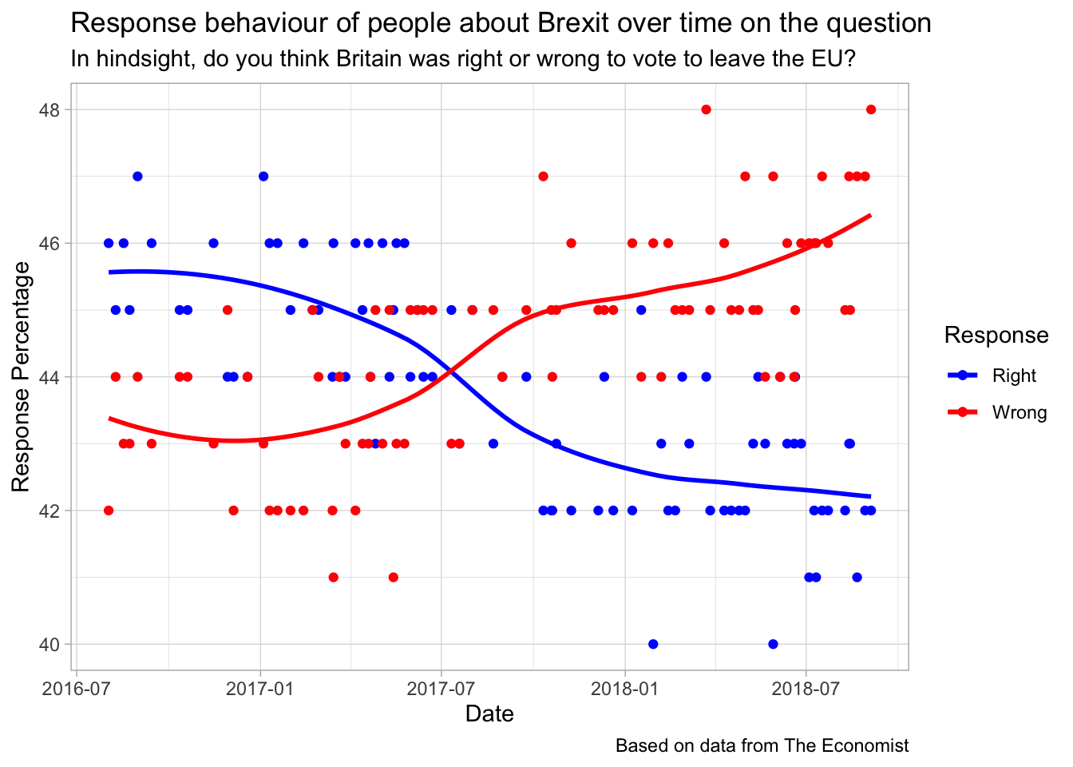
#tidytuesday
Inspired by the Economist article here:

Slide 5
Miscellaneous Student Examples

Slide 6
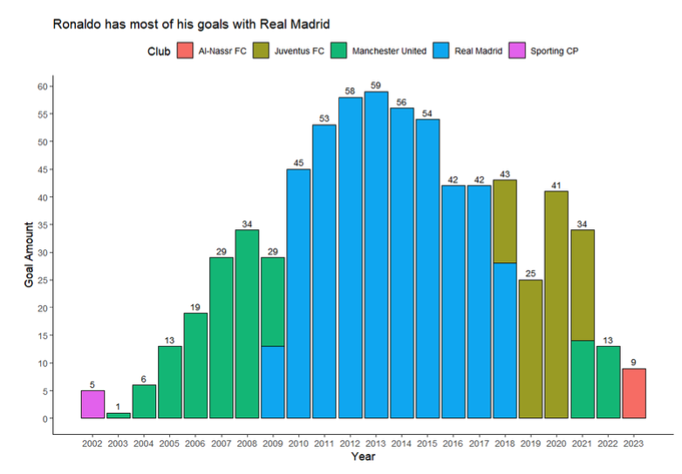
Histogram with color mapping

Slide 7
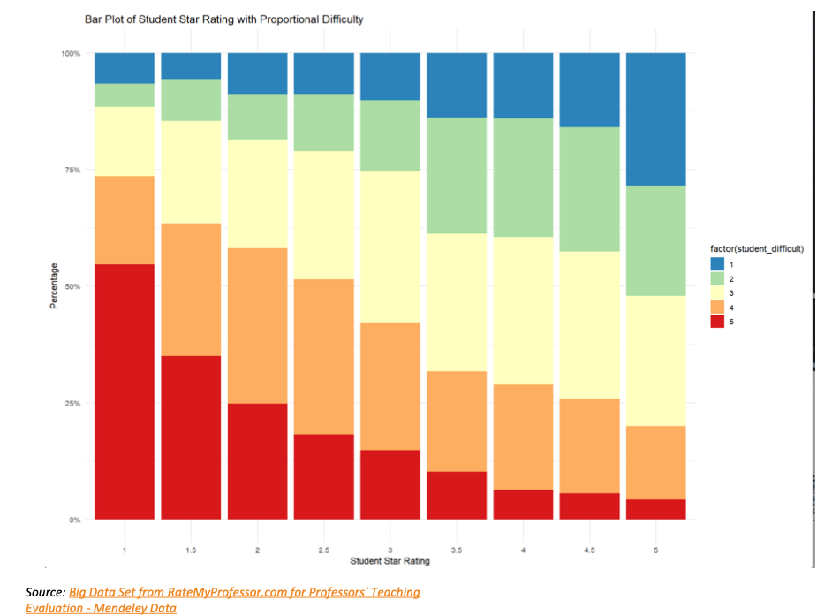
Bar Plot with Color Mapping
Title should describe the findings in the chart, otherwise great use of color and labeling (I like the caption with the data source)

Slide 8
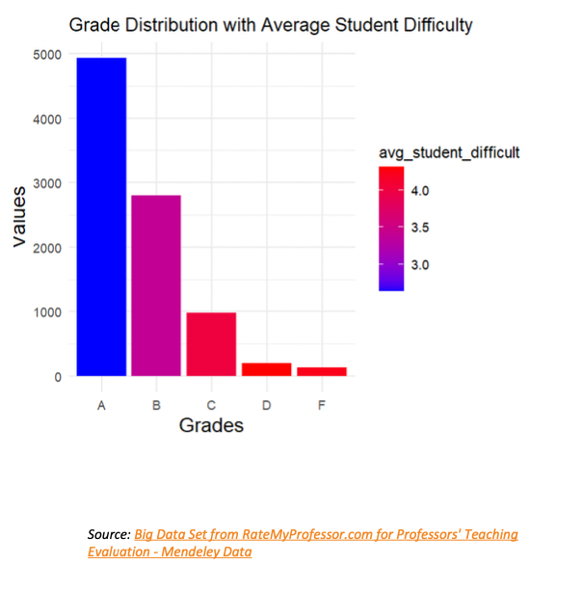
Bar Plot with Color Mapping
Interesting use of color (color is a gradient based on the difficulty rating)

Slide 9
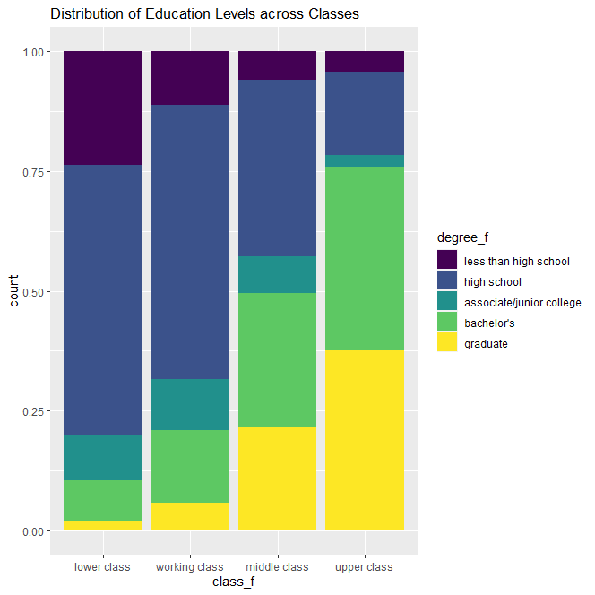
More education often leads to higher income
Education can also show people ways of moving up in social class
Higher education is expensive
Thoughtful interpretation of the findings (upper class has higher levels of educational attainment)
Good use of color gradient (viridis)

Slide 10
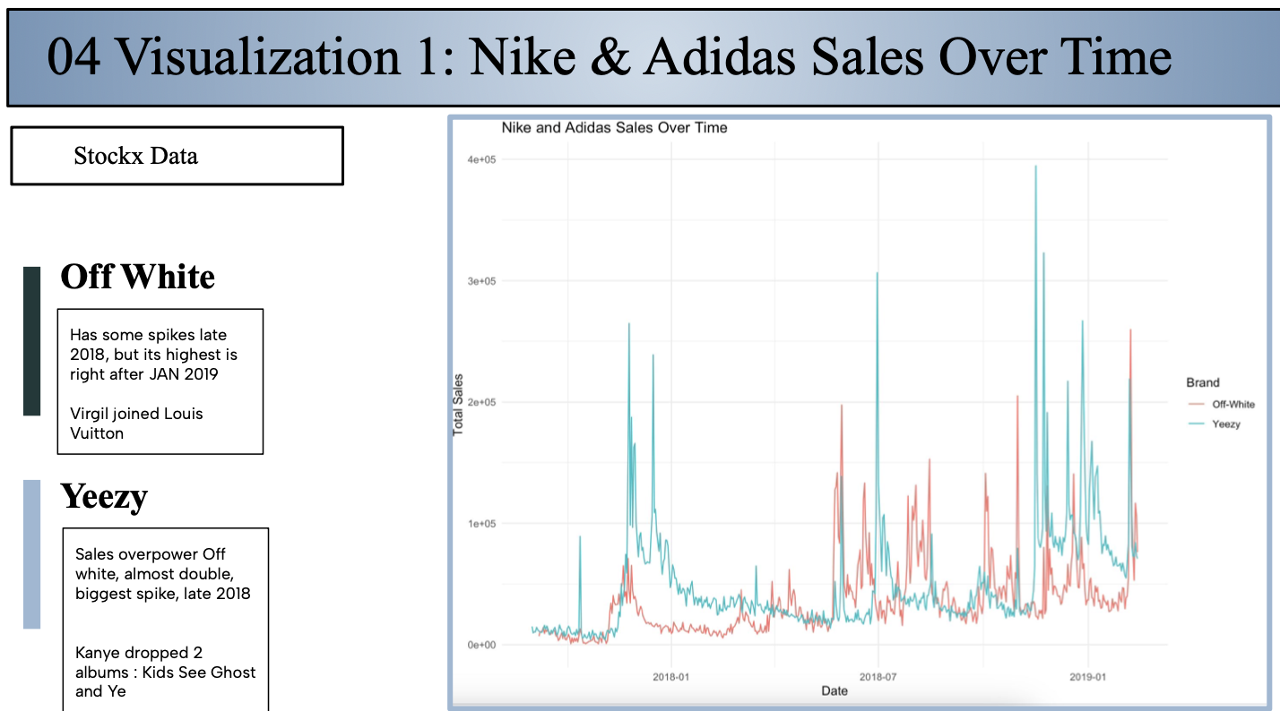
Providing Context
Student provides additional context for the findings in the chart (uses knowledge of sneaker related events)

Slide 11
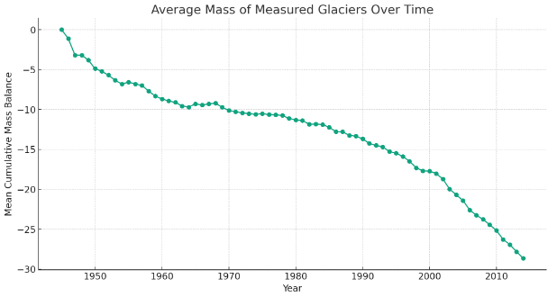
Line Graph (Trends over Time)
It’s not that impressive to see a single line graph- should try to group by an additional variable

Slide 12
Don’t do this
The plot showing the average mass of measured glaciers over time, based on the dataset you provided. The plot illustrates the trend in the mean cumulative mass balance of glaciers from 1945 onwards.
One of the most direct effects of melting glaciers is the rise in sea levels. Glaciers store a large amount of the Earth's freshwater, and when they melt, this water flows into the oceans. This contributes to the overall increase in sea levels, which can lead to the flooding of coastal areas, affecting millions of people worldwide.
Glaciers are important habitats for unique ecosystems. As they retreat, these ecosystems can be lost.

Slide 13
Outline
Visualization Best Practices
Customizing your plots

Slide 14
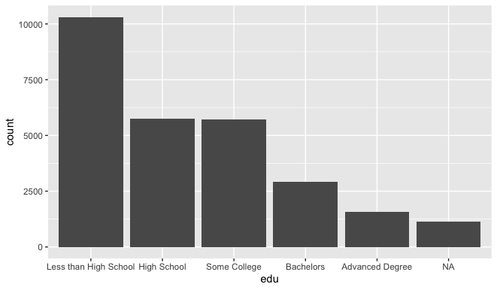
Bar Plot Customizations
What can we do to improve this bar plot?
ggplot(data=acs,
mapping= aes(x=edu))+
geom_bar() +

Slide 15
Class Exercise
improve on this bar plot by adjusting:
labels
scales
theme

Slide 16
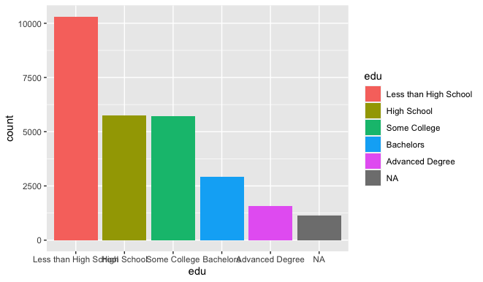
Bar Plot Customizations: add color
We use the fill argument to add color to the bar chart
ggplot will choose the default color palette
ggplot(data=acs,
mapping= aes(x=edu))+
geom_bar ( aes(fill=edu))

Slide 17
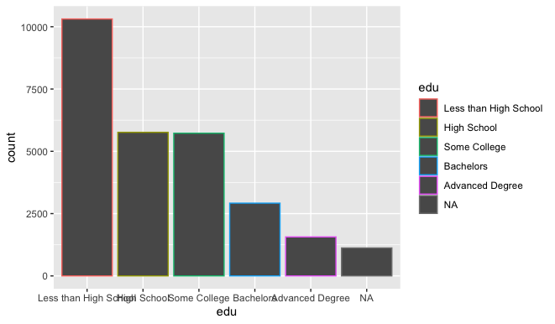
Bar Plot Customizations: fill vs color
Remember to use fill instead of color for 2d shapes
otherwise only the outline gets colored
ggplot(data=acs,
mapping= aes(x=edu))+
geom_bar ( aes(color=edu))

Slide 18

Bar Plot Customizations: fill vs color
can we use fill and color?
Sure!
I added a black border in this example
ggplot(data=acs,
mapping= aes(x=edu))+
geom_bar ( aes(fill=edu), color = "black" )

Slide 19
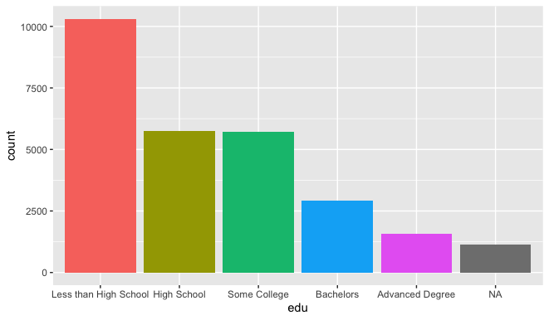
Bar Plot Customizations: Remove legend
We can remove the legend because it doesn’t provide any additional information
legend.position controls where the legend is drawn:
right (the default)
left
top
bottom
none (suppress legend)
ggplot(data=acs,
mapping= aes(x=edu))+
geom_bar ( aes(fill=edu)) +
theme(legend.position = 'none')

Slide 20
Color Scales for Categorical Variables
To adjust color on a 1-d shape (point), we can use:
scale_color_manual(): manually create color scale
scale_color_brewer(): use a ColorBrewer palette
To adjust color on a 2-d shape (bar), we can use:
scale_fill_manual(): manually create color scale
scale_fill_brewer(): use a ColorBrewer palette

Slide 21
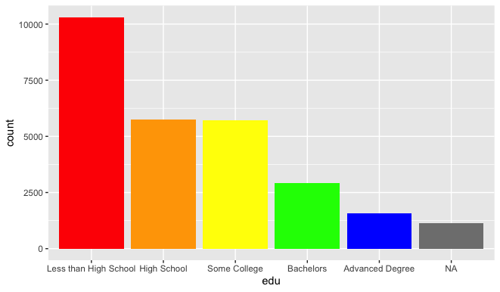
Manually Select Color Scale
ggplot(data=acs,
mapping= aes(x=edu))+
geom_bar(aes(fill=edu))+
theme(legend.position = 'none') +
scale_fill_manual(values= c("red", "orange", "yellow", "green", "blue"))
Note: the color for NA can’t be adjusted manually

Slide 22
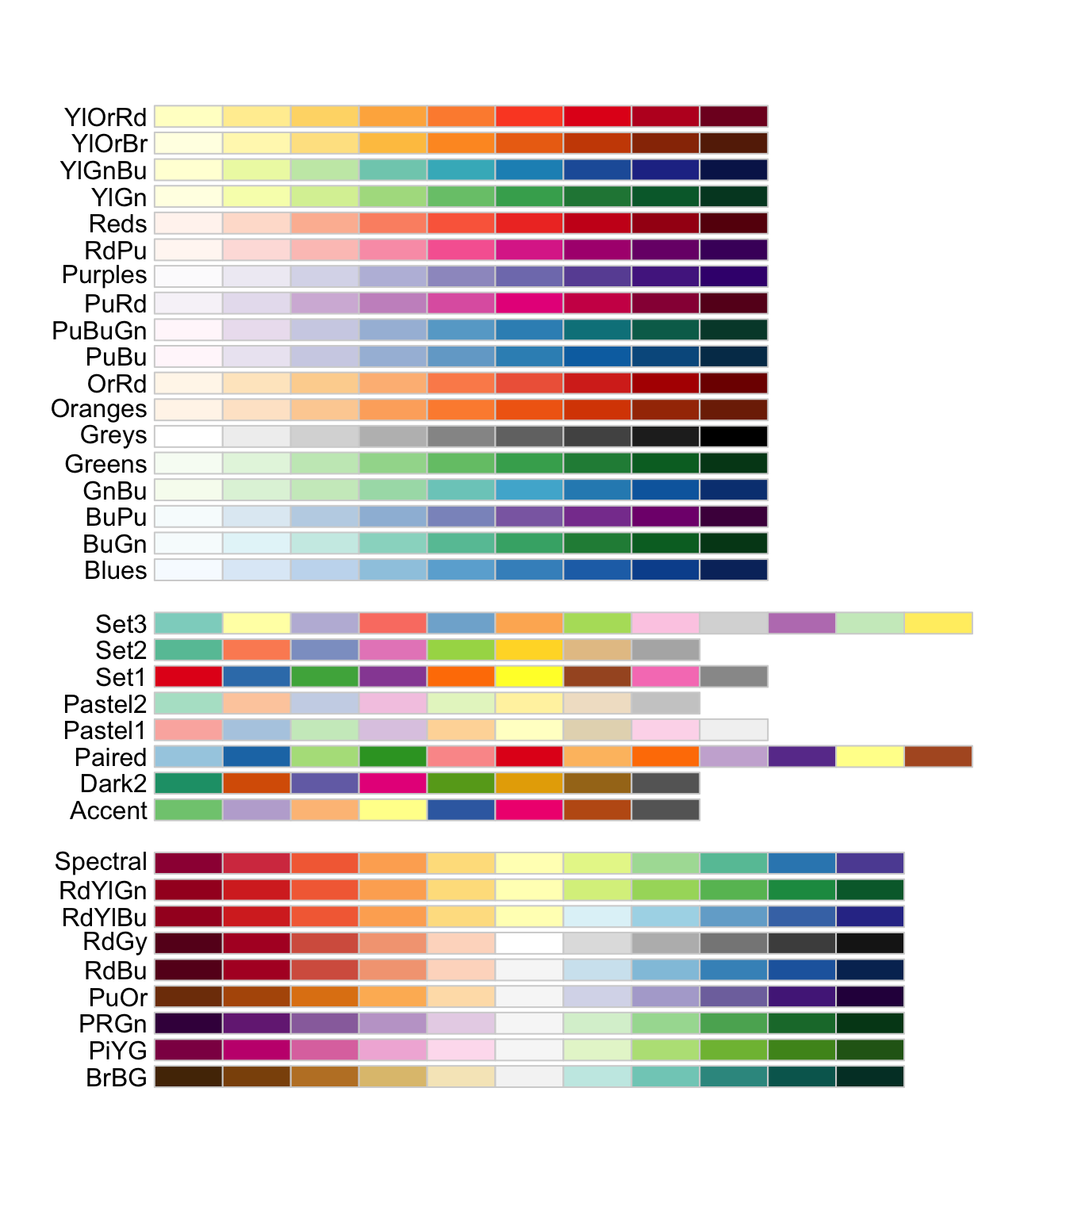
ColorBrewer Sequential Color Scales
ColorBrewer provides sets of colors (palettes)
Sequential palettes are good for ordinal categorical variables
Educational levels:
high school
college
graduate school

Slide 23
ColorBrewer Diverging Color Scales
Diverging palettes are good for ordinal categorical variables
Use this when your values are ordered in two directions relative to a center.
political affiliation:
liberal
centrist
conservative

Slide 24
ColorBrewer Qualitative Color Scales
Qualitative (nominal) palettes are good for categorical Variables whose values have no ordering.
Major:
Economics
Business
Statistics

Slide 25
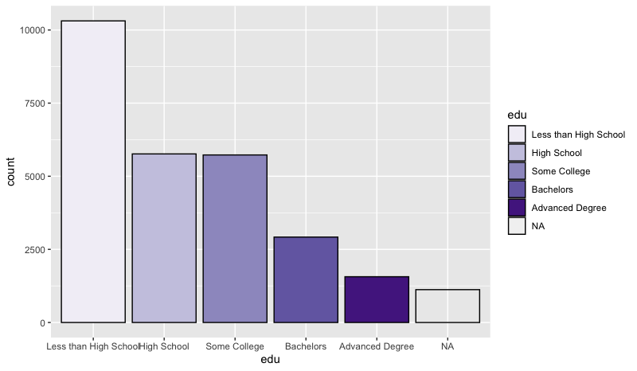
Change the Palette
ggplot(data=acs,
mapping= aes(x=edu))+
geom_bar(aes(fill=edu), color = "black" )+
scale_fill_brewer(palette= "Purples")
Education is ordinal, so I will select a sequential color scale

Slide 26
What happened?
ggplot(data=acs,
mapping= aes(x=edu))+
geom_bar(aes(fill=edu), color = "black" )+
scale_color_brewer(palette= "Purples")
I changed the palette for 1d objects (lines and points), not 2d objects

Slide 27
Class Exercise
Make a bar plot of race
use the Set1 color palette
https://pollev.com/vsovero

Slide 28
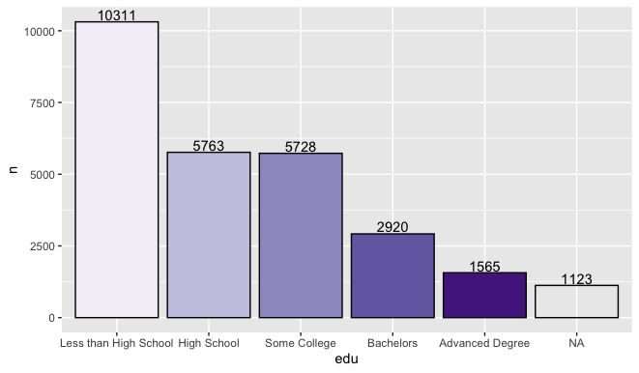
Adding text labels
Adding the values of the counts provides more detail to our bar plots

Slide 29
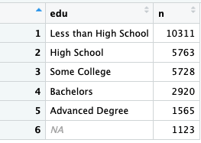
Step 1: Make a Frequency Table
degree_frequency<-acs%>%
count(edu)
This gives us the values to add to the bar plot

Slide 30
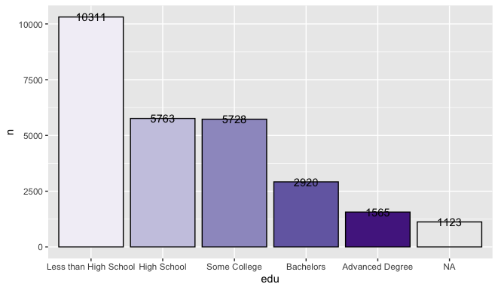
Step 2: Make a Bar Plot with geom_col()
ggplot(data=degree_frequency,
mapping= aes(x=edu, y=n))+
geom_col(aes(fill=edu), color = "black" )+
geom_text(aes(label=n )+
scale_color_brewer(palette= "Purples" )+
theme(legend.position = 'none') +
We use geom_col() instead of geom_bar()
This means we use the frequency table as our data
geom_text() adds a label at the y-values

Slide 31

Adjust the position of the text
ggplot(data=degree_frequency,
mapping= aes(x=edu, y=n))+
geom_col(aes(fill=edu), color = "black" )+
geom_text(aes(label=n, vjust=-.3 )+
scale_color_brewer(palette= "Purples" )+
theme(legend.position = 'none') +
We can adjust the position of the text using vjust and hjust

Slide 32
Class Exercise
Make a bar plot of race
use the Set1 color palette
add the counts to the top of each bar
https://pollev.com/vsovero

Slide 33
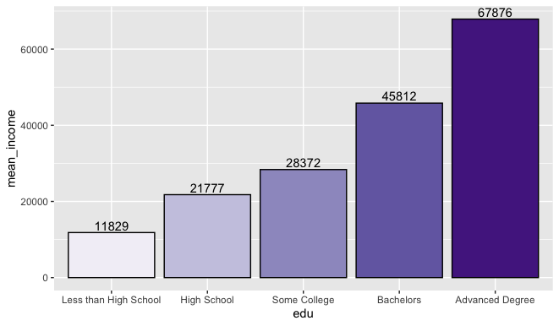
Means by group
We can take a similar approach to plotting mean income by education:
First, create a table of mean income by education
Next, use geom_col()
Add labels using geom_text()

Slide 34
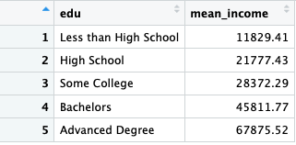
Mean Income by Education
income_by_edu<-acs %>%
filter(!is.na(edu)) %>%
group_by(edu) %>%
summarize(mean_income = mean(income, na.rm = TRUE))

Slide 35
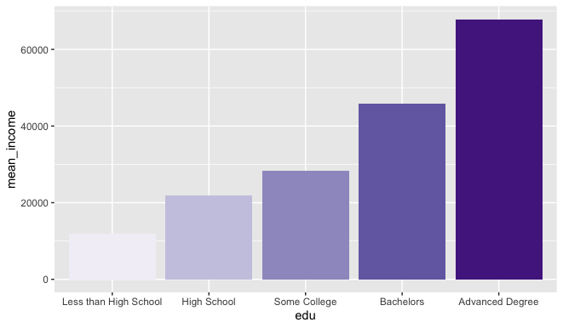
Bar Plot of Mean Income by Education
ggplot(data=income_by_edu,
mapping= aes(x=edu, y=mean_income))+
geom_col(aes(fill=edu))+
scale_color_brewer(palette= "Purples" )+
theme(legend.position = 'none') +

Slide 36
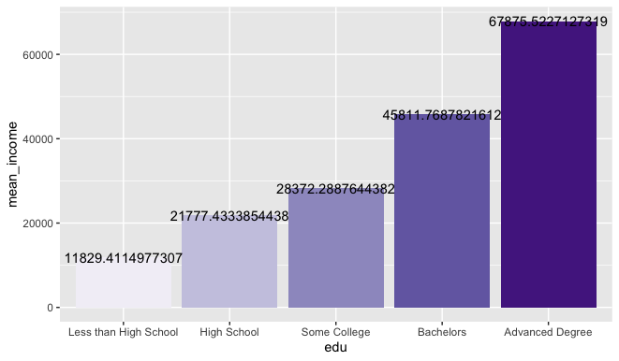
Add text (mean income values)
ggplot(data=income_by_edu,
mapping= aes(x=edu, y=mean_income))+
geom_col(aes(fill=edu))+
geom_text(aes(label=mean_income ))+
scale_color_brewer(palette= "Purples" )+
theme(legend.position = 'none') +

Slide 37

Add text (rounded mean income values)
ggplot(data=income_by_edu,
mapping= aes(x=edu, y=mean_income))+
geom_col(aes(fill=edu))+
geom_text(aes(label=round(mean_income)))+
scale_color_brewer(palette= "Purples" )+
theme(legend.position = 'none') +

Slide 38
Add text (adjust position)
ggplot(data=income_by_edu,
mapping= aes(x=edu, y=mean_income))+
geom_col(aes(fill=edu))+
geom_text(aes(label=round(mean_income), vjust=-.3 )+
scale_color_brewer(palette= "Purples" )+
theme(legend.position = 'none') +

Slide 39
Visual Decluttering
We reviewed this earlier, but I’ll repeat it again
Less is more, don’t over clutter your graphs

Slide 40
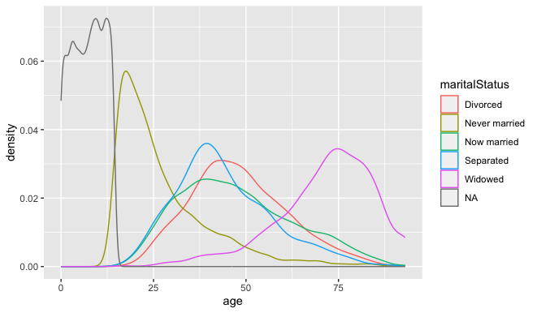
Visual Decluttering
ggplot(data=acs,
mapping= aes(x=age))+
geom_density(aes(color=maritalStatus))
Things I don’t like:
NA needs to be removed
too many lines on a graph

Slide 41
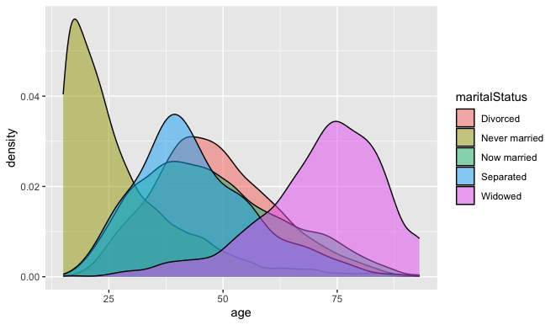
Try fill instead of color
ggplot(data=acs_marital,
mapping= aes(x=age))+
geom_density(aes(fill=maritalStatus), alpha=.5)
We can adjust the transparency as well (alpha)

Slide 42
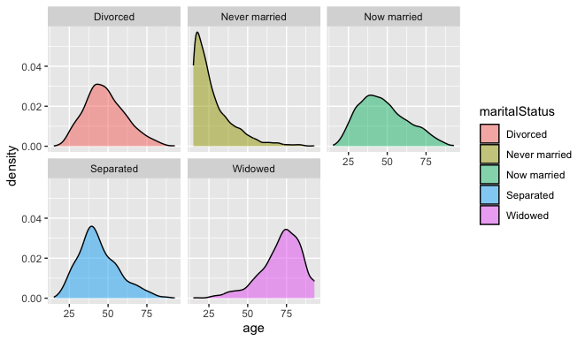
Try Faceting
ggplot(data=acs_marital,
mapping= aes(x=age))+
geom_density(aes(fill=maritalStatus), alpha=.5) +
facet_wrap(. ~ maritalStatus)
Breaks up the graph into separate parts

Slide 43
Class Exercise
Select individuals with an advanced degree earning 200,000 or less
create a density plot of income faceted by race
https://pollev.com/vsovero

Slide 44
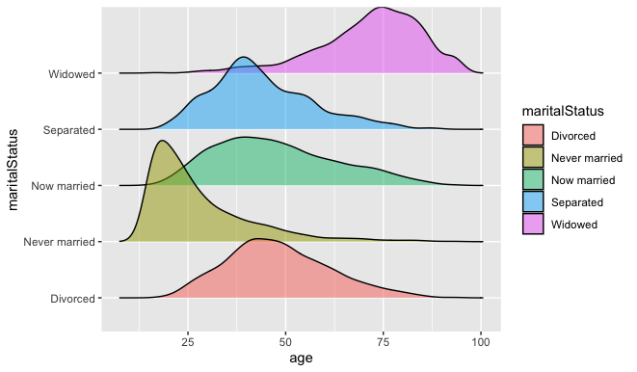
Try ggridges
ggplot(data=acs_marital,
mapping= aes(x=age))+
geom_density_ridges(aes(fill=maritalStatus), alpha=.5)
Breaks up the graph into separate parts, but with a slight overlap
https://cran.r-project.org/web/packages/ggridges/vignettes/introduction.html

Slide 45
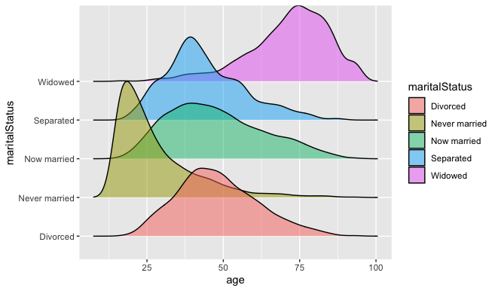
Try ggridges
ggplot(data=acs_marital,
mapping= aes(x=age))+
geom_density_ridges(aes(fill=maritalStatus), alpha=.5, scale=3)
You can make the overlap larger with the scale argument (bigger number gives a greater overlap)
https://cran.r-project.org/web/packages/ggridges/vignettes/introduction.html

Slide 46
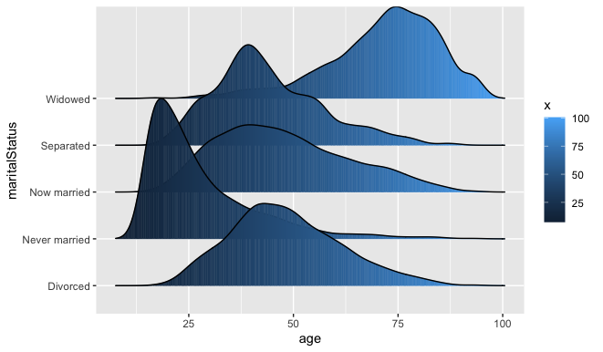
Try ggridges
ggplot(data=acs_marital,
mapping= aes(x=age))+
geom_density_ridges(aes(fill=stat(x)), scale=3)
Use color to represent values on the x-axis (age)
Very fancy.
https://cran.r-project.org/web/packages/ggridges/vignettes/introduction.html

Slide 47
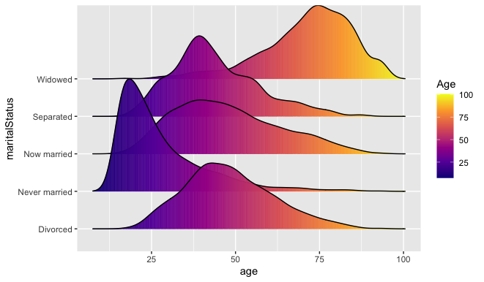
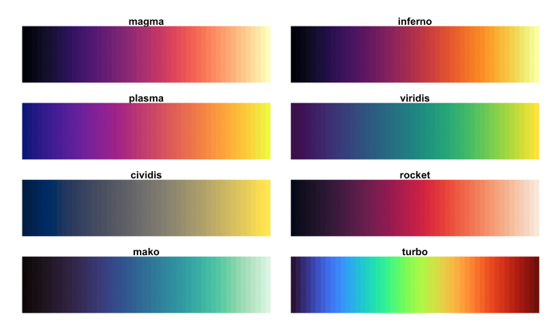
Try ggridges
ggplot(data=acs_marital,
mapping= aes(x=age))+
geom_density_ridges(aes(fill=stat(x)), scale=3)
scale_fill_viridis_c(name= "Age", fill= "plasma" )+
Use a viridis color palette (plasma)
Extra fancy.
https://cran.r-project.org/web/packages/ggridges/vignettes/introduction.html

